Slide 1


FAKE NEWS PREDICTION

Slide 2
What is fake news ?
false information that is broadcast or published as news for fraudulent or politically motivated purposes
fake news stories usually spread through social media like Facebook, twitter etc..
Major problems -
Fake news influences people’s perceptions
The rise of fake news has become a global problem now that even major tech companies like Facebook and google struggling to solve it can difficult to determine whether a text factual without additional context and human judgement
Fake news can be used as a tool for manipulation, whether it's for political or financial gain. It can be used to sway public opinion or to push certain agendas.
Fake news erodes the credibility of the media and undermines the public's trust in traditional news sources. This can make it difficult for people to distinguish between real and fake news, leading to further confusion and mistrust.

Slide 3
TYPES OF FAKE NEWS
1) VISUAL BASED FAKE NEWS –
VISUAL BASED ARE MAINLEY PHOTOSHOPPED IMAGES AND FAKE VEDIOS WHICH ARE POSTED IN SOCIAL MEDIAS
2) LINGUISTIC BASED FAKE NEWS –
LINGUISTIC BASED ARE MAINELY THE MANUPLATION OF TEXT AND STRING CONTENT THE ISSUE WITG BLOGS, NEWS OR EMAILS
NOTE –
WE ARE DEALING WITH LINGUISTIC BASED FAKE NEWS

Slide 4

AGENDA -
The projects aims to develop a method of detecting and classifying the fake news stories using machine learning algorithm
The main goal is to identify fake news, which is a classic text classification issue
We gathered the raw data pre-processed to text and translated our articles into supervised model features.
Our goal is to develop a model that classifies a given news article as either fake or true

Slide 5
Workflow -
Sss
Data set loading
Data pre processing – understanding the data and checking dataframe of the data, checking if any null values or missing values are there and drop duplicates and doing some visualization to get more insights of the data
Feature selection – drop unwanted columns if it is not contributing to model building
Applying classification and model construction
Checking model’s performance
The steps in this procedure are as follows –

Slide 6
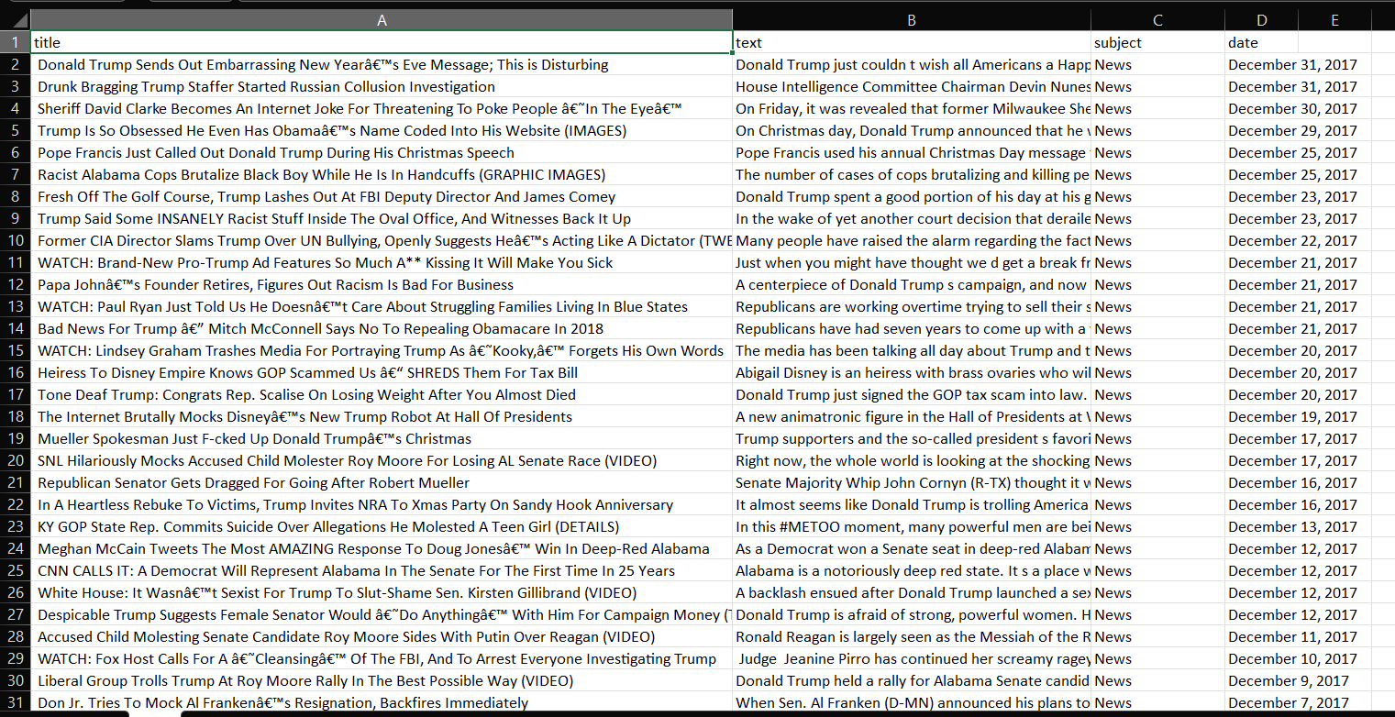
Data set
Data set is imported from Kaggle and we have two datasets fake and true
and we are going merge both datasets into one
The size of true dataset is (21415,5)
The size of fake dataset is (23481,5)
Total after merging (44898,5)
25% of the dataset is used to test the data
75% of the dataset is used to train the data

Slide 7
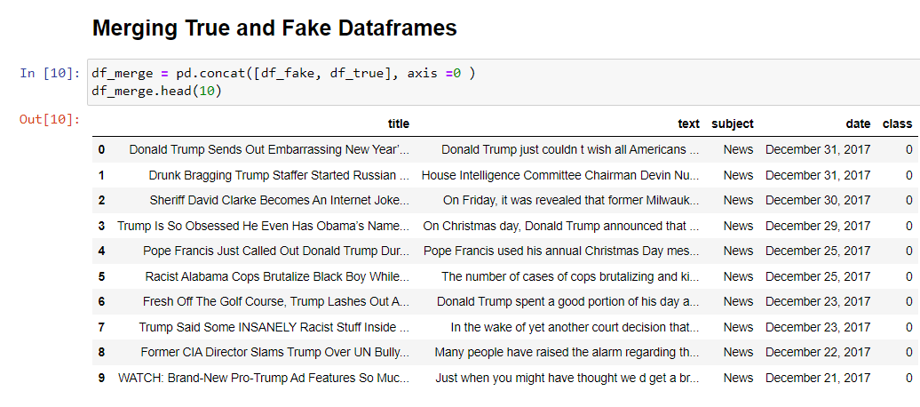
Sddwwds note- we have stored fake and true data in one variable and named it as df_merge target variable is “class” 0 represents fake news and 1 represents real news

Slide 8
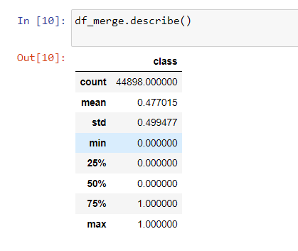
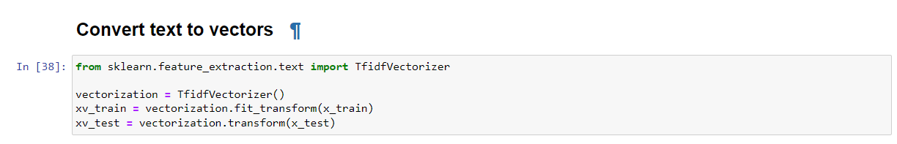
As you can observe only target variable is numerical and rest of the columns are categorical so describe function showing only class column
By converting text into vectors we can use various mathematical and statical techniques
To analyse and manipulate the data. This allows us to perform tasks such as classification,
Sentiment analysis and transaction.
Note – In this case we use vectorization to training data only.

Slide 9
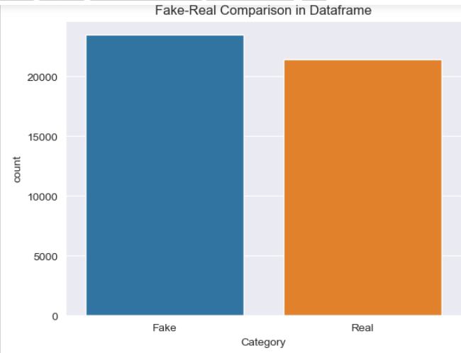
Doing some visualization to get more insights about data here we can clearly observe that fake news is more than real news.

Slide 10
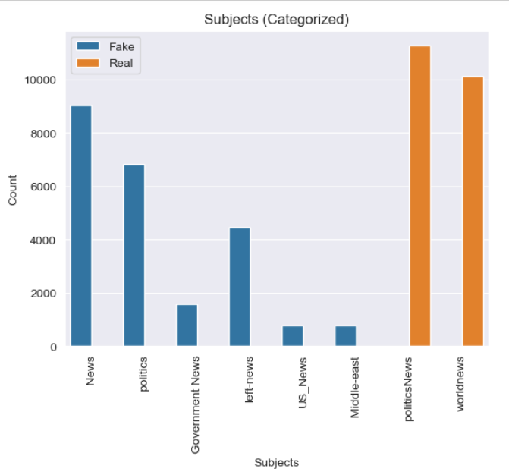
In fake news particularly general news is more in number In real news political news is more in number

Slide 11
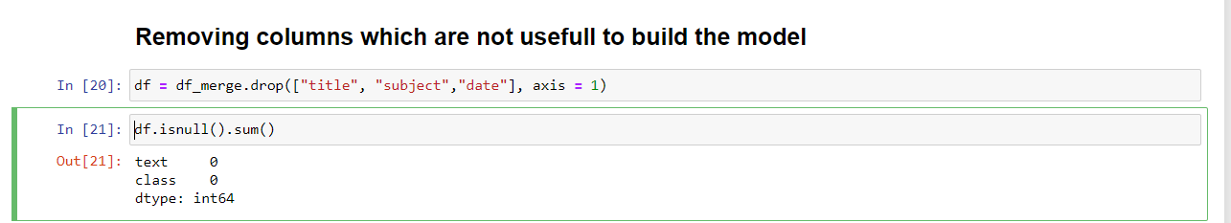
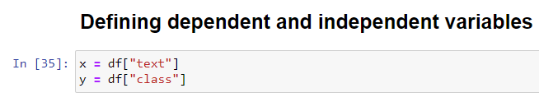
Doing some feature engineering dropping date,subject,title column which is not useful to build the model
BUILDING MODEL -
DEFINING TARGET VARIABLE(Y) AND INDEPENDENT VARIABLE(X)

Slide 12
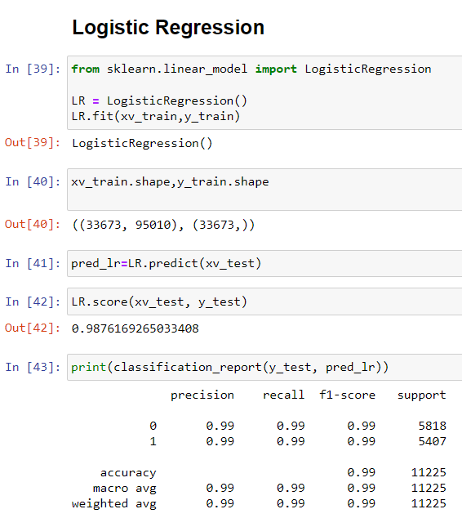
Doing train_test_split
Here we are going to apply logistic decsiontree and random forest algorithm
Importing necessary library
1) Logistic regression

Slide 13
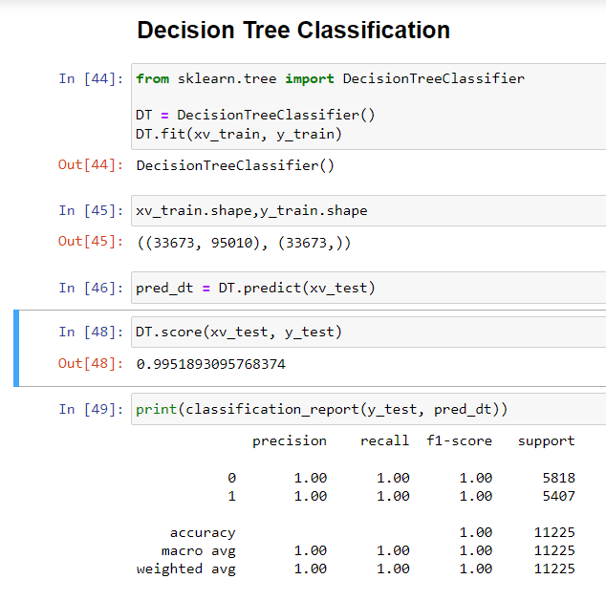
Decision tree algorithm

Slide 14
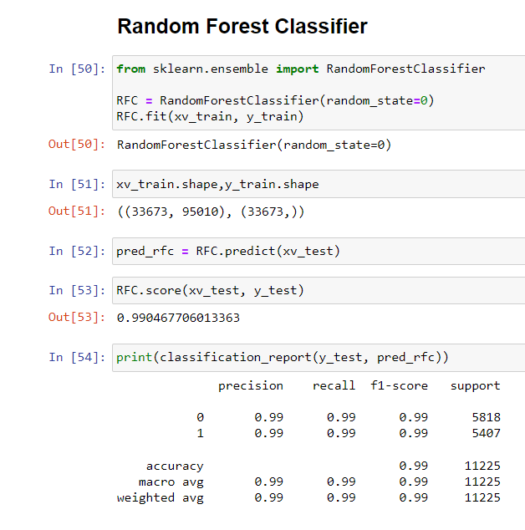
Random forest algorithm

Slide 15
Some of the drawn conclusion -
We use confusion matrix to calculate accuracy level
Decision tree and random forest is more accurate then logistic regression algorithm
Both random forest and decision tree providing accuracy around 99%. Logistic is giving accuracy around 98%
Text vectorization is a fundamental step in fake news detection as it transforms unstructured text data into a structured numerical format that can be processed by machine learning models.
As we can observe fake news is more than real news’
However, it is important to note that fake news detection is a challenging task that requires ongoing research and development.
In summary, fake news detection is a critical area of research in machine learning, and its success depends on the development of robust and accurate models that can detect and prevent the spread of misinformation.

Slide 16
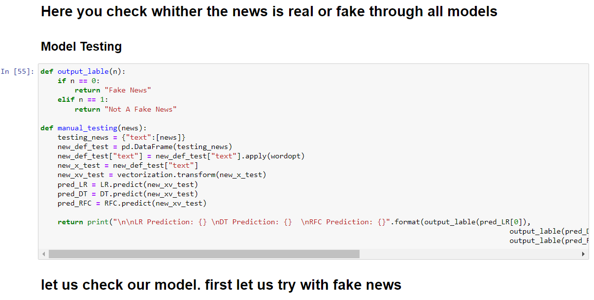
Here you can check whither news is fake or real

Slide 17
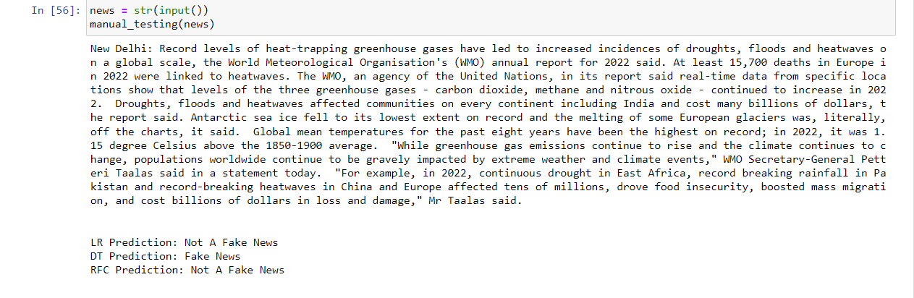
Ex – let’s us try with real news
Lr and rfc is telling that it is not a fake news but dt is predicting it as fake news in
Reality it is real news
Note – model can not give 100% accuracy

